Slide 1
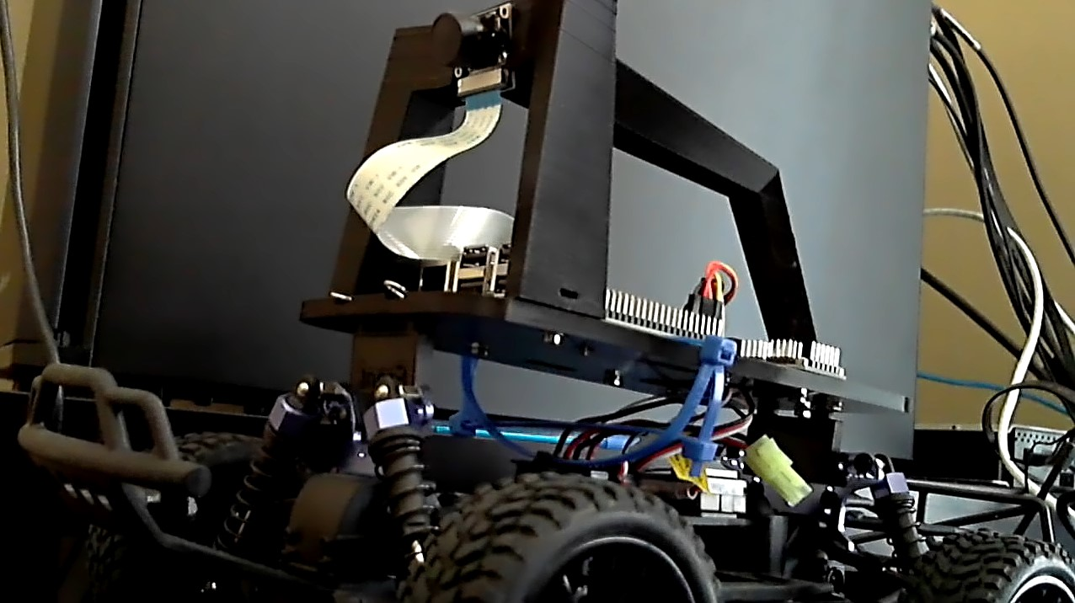
Springboard Capstone Project Two
Donkey Car
Author: Ning Leung
Date: 3/31/2019

Slide 2
Outline
Introduction
Donkey Car and Data Set
Data Gathering in Donkey_gym
Analysis and Findings
Results
Next Steps

Slide 3
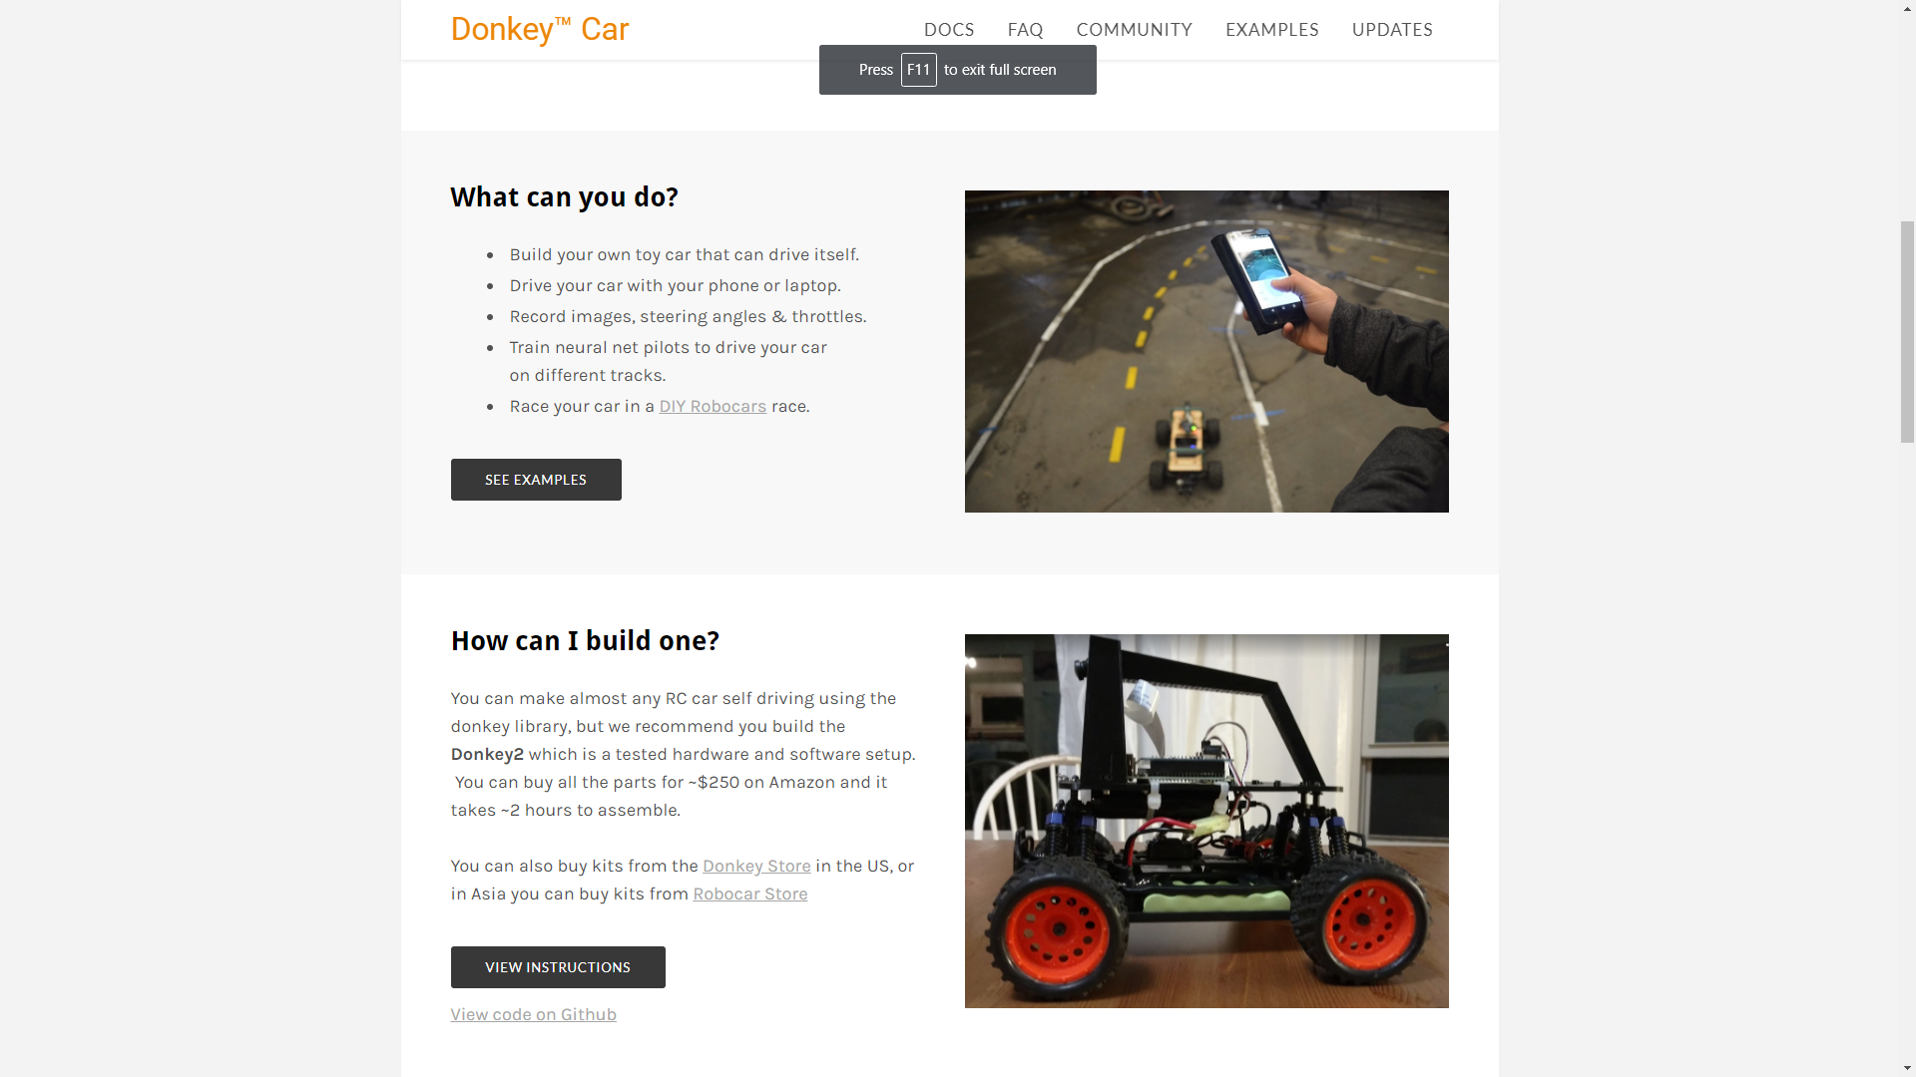
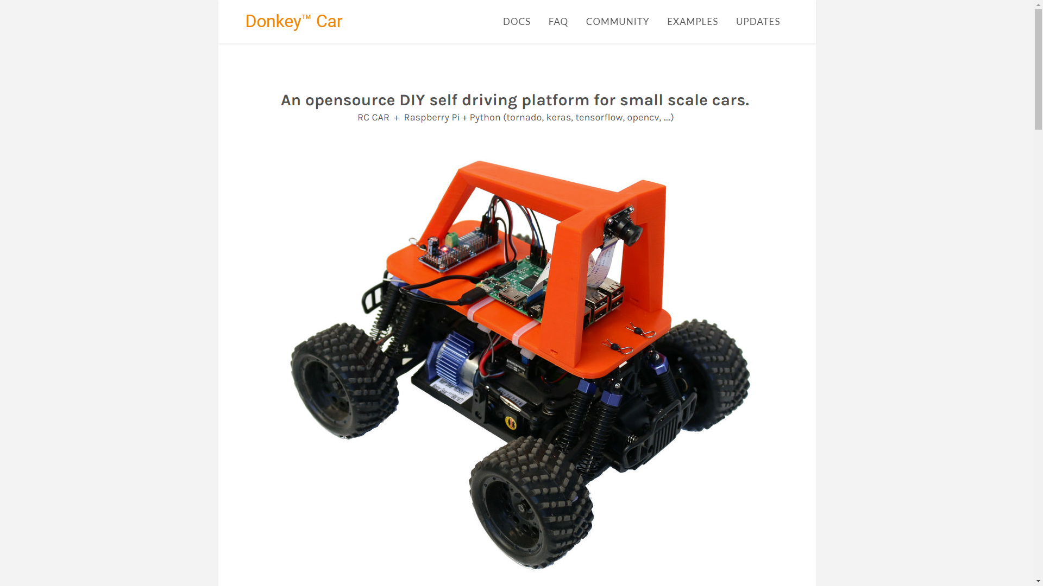
Donkey car and data set

Slide 4
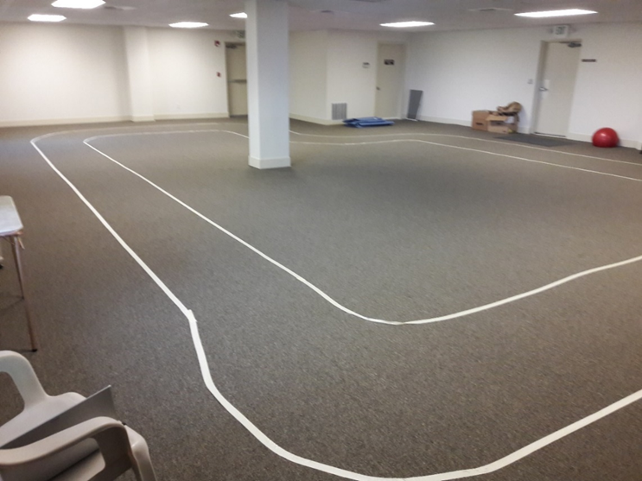
Donkey car and data set
- Objective: Create a Donkeycar, gather train and test data. Investigate and manipulate cNN to alter driving behavior.
- Bonus: For the experience, make own track to gather and test data

Slide 5
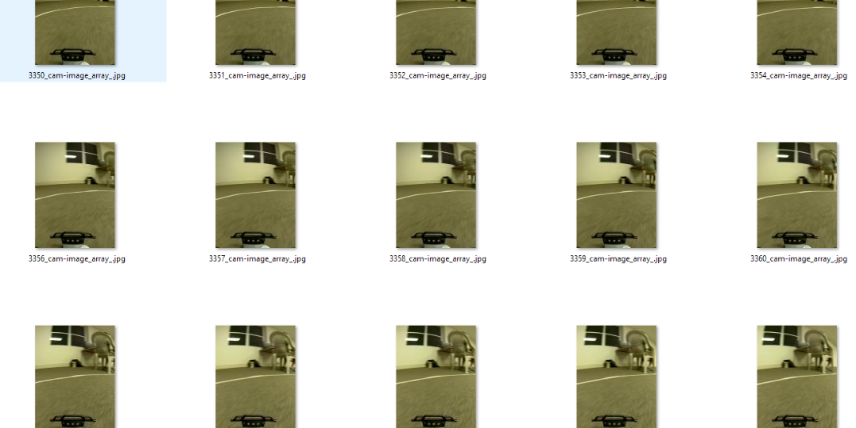
Donkey car and data set

Slide 6
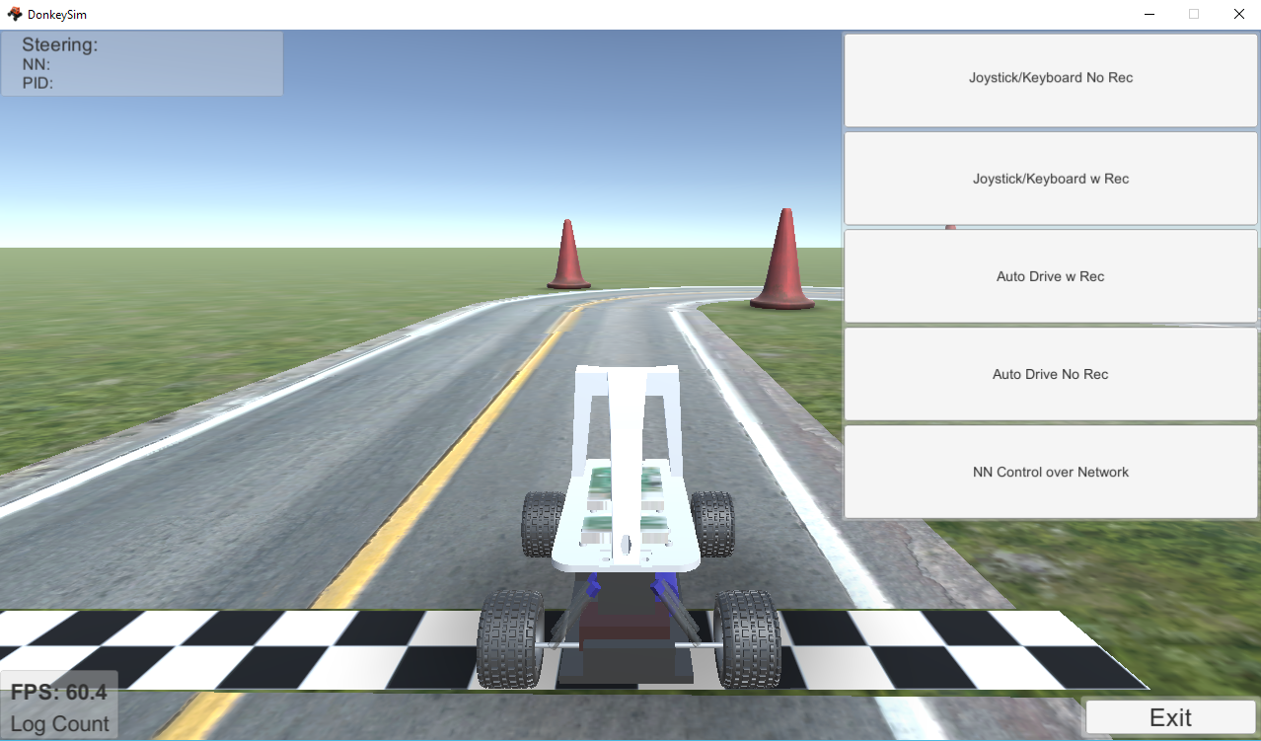
Data Gathering in Donkey_gym
To save time and acquire more data set, switched to the simulator
Donkey_gym functions as a test environment for different methodologies and techniques for training and testing a vehicle.

Slide 7
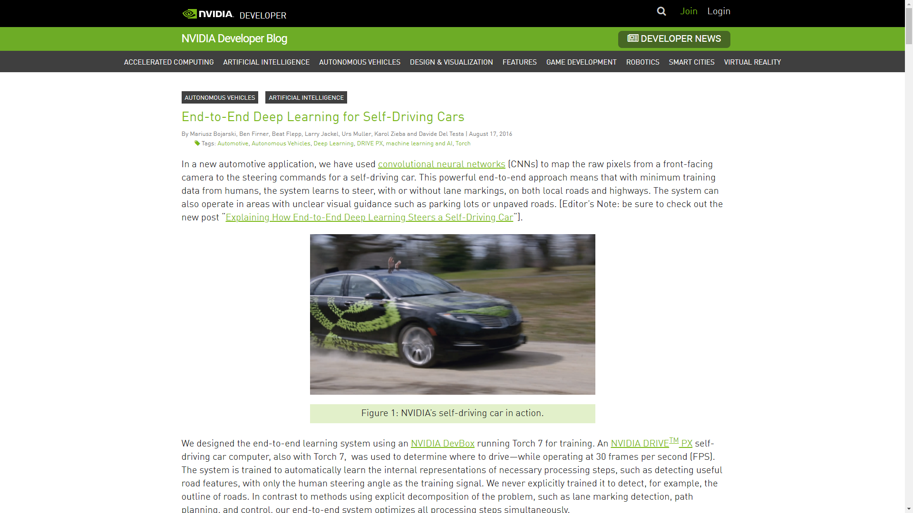
Data Gathering in Donkey_gym
Foundation of donkey’s cNN architecture
5 conv2D layers with dropouts in between.
Model inspired by nVidia’s DAVE model.

Slide 8

Machine learning
The primary goal of this Machine Learning was to gather data set to train steering and throttle data to enhance performance of donkey car (physical/virtual)
APPROACH
1. Gather driving data [steering, throttle]
2. Train in cNN
3. Test and Evaluate results
4. Modify and re-iterate model
5. Repeat until satisfy

Slide 9
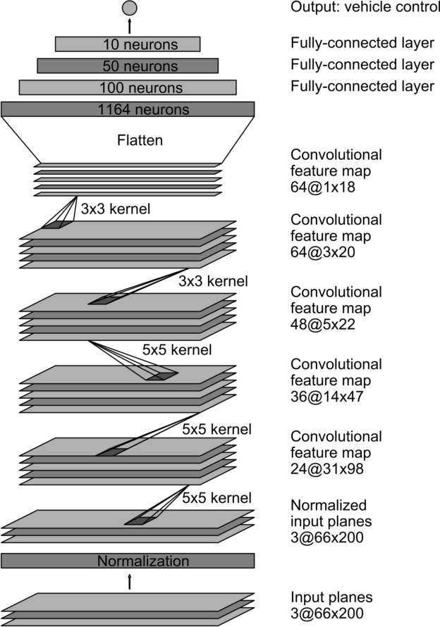
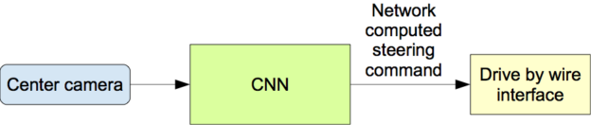
Machine Learning - CNN
- Convolution Neural Networks from nVidia’s article that our model is based off of.
- Camera captures image and throttle and steering data is sent to the cNN to output each comanmnds respectively

Slide 10
Machine Learning – LAYERS MODIFICATION
Key Layers Modifications
conv2D() – Extracts high-level features by replacing data for each pixel with a value computed from pixels covered. E.g. 5x5, 3x3, 1x1 kernels.
Activation Function: ReLU. Nonlinear activation ransform output from (x) = max(0,x)
Strides – Number of units the filter shifts each time
Dropout() – Dropout sets a proportion of activations (neuron outputs) passed on to the next layer to zero. Zeroed-outputs are chosen randomly. This process reduces overfitting.
MaxPool2D() – Pooling layers reduce spatial size of the output by replacing values in the kernel by a function of those values. In this case, maxpooling, you take the maximum out of every pool.
Dense() - This layer is a fully connected layer, all neurons in a layer are connected between the input and output layer.

Slide 11
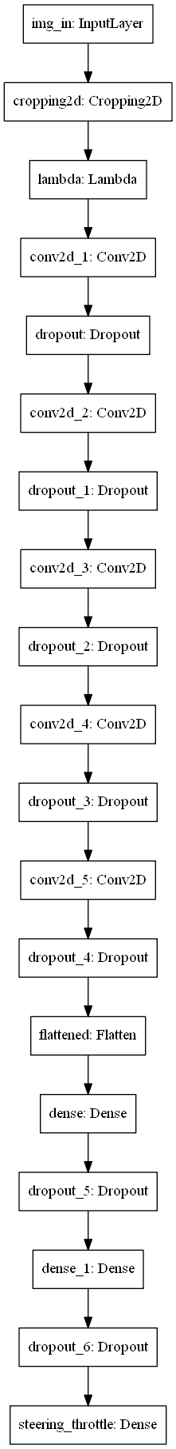
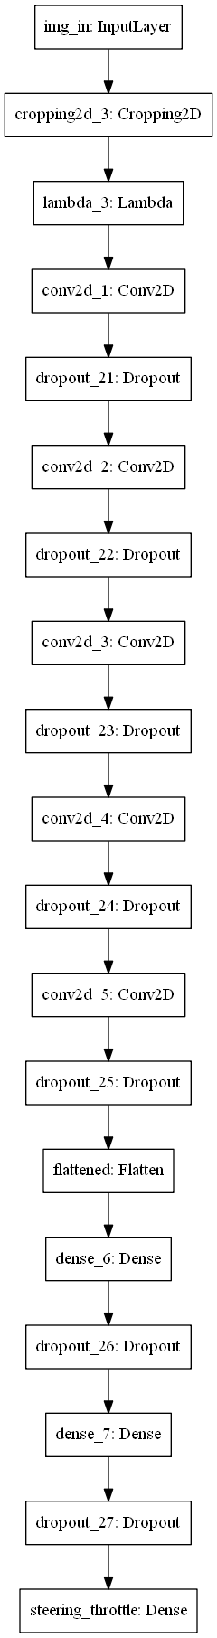
_________________________________________________________________
Layer (type) Output Shape Param #
===================================================
img_in (InputLayer) (None, 120, 160, 3) 0
_________________________________________________________________
cropping2d (Cropping2D) (None, 110, 160, 3) 0
_________________________________________________________________
lambda (Lambda) (None, 110, 160, 3) 0
_________________________________________________________________
conv2d_1 (Conv2D) (None, 53, 78, 24) 1824
_________________________________________________________________
dropout (Dropout) (None, 53, 78, 24) 0
_________________________________________________________________
conv2d_2 (Conv2D) (None, 25, 37, 32) 19232
_________________________________________________________________
dropout_1 (Dropout) (None, 25, 37, 32) 0
_________________________________________________________________
conv2d_3 (Conv2D) (None, 11, 17, 64) 51264
_________________________________________________________________
dropout_2 (Dropout) (None, 11, 17, 64) 0
_________________________________________________________________
conv2d_4 (Conv2D) (None, 9, 15, 64) 36928
_________________________________________________________________
pool_1 (MaxPooling2D) (None, 4, 7, 64) 0
_________________________________________________________________
conv2d_5 (Conv2D) (None, 2, 5, 64) 36928
_________________________________________________________________
dropout_3 (Dropout) (None, 2, 5, 64) 0
_________________________________________________________________
flattened (Flatten) (None, 640) 0
_________________________________________________________________
dense (Dense) (None, 100) 64100
_________________________________________________________________
dropout_4 (Dropout) (None, 100) 0
_________________________________________________________________
dense_1 (Dense) (None, 50) 5050
_________________________________________________________________
dropout_5 (Dropout) (None, 50) 0
_________________________________________________________________
steering_throttle (Dense) (None, 2) 102
===================================================
Total params: 215,428
Trainable params: 215,428
Non-trainable params: 0
_________________________________________________________________
Layer (type) Output Shape Param #
=================================================================
img_in (InputLayer) (None, 120, 160, 3) 0
_________________________________________________________________
cropping2d_13 (Cropping2D) (None, 110, 160, 3) 0
_________________________________________________________________
lambda_13 (Lambda) (None, 110, 160, 3) 0
_________________________________________________________________
conv2d_1 (Conv2D) (None, 53, 78, 24) 1824
_________________________________________________________________
dropout_78 (Dropout) (None, 53, 78, 24) 0
_________________________________________________________________
conv2d_2 (Conv2D) (None, 25, 37, 32) 19232
_________________________________________________________________
dropout_79 (Dropout) (None, 25, 37, 32) 0
_________________________________________________________________
conv2d_3 (Conv2D) (None, 11, 17, 64) 51264
_________________________________________________________________
dropout_80 (Dropout) (None, 11, 17, 64) 0
_________________________________________________________________
conv2d_4 (Conv2D) (None, 9, 15, 64) 36928
_________________________________________________________________
dropout_81 (Dropout) (None, 9, 15, 64) 0
_________________________________________________________________
conv2d_5 (Conv2D) (None, 7, 13, 64) 36928
_________________________________________________________________
dropout_82 (Dropout) (None, 7, 13, 64) 0
_________________________________________________________________
flattened (Flatten) (None, 5824) 0
_________________________________________________________________
dense_26 (Dense) (None, 100) 582500
_________________________________________________________________
dropout_83 (Dropout) (None, 100) 0
_________________________________________________________________
dense_27 (Dense) (None, 50) 5050
_________________________________________________________________
dropout_84 (Dropout) (None, 50) 0
_________________________________________________________________
steering_throttle (Dense) (None, 2) 102
=================================================================
Total params: 733,828
Trainable params: 733,828
Non-trainable params: 0

Slide 12
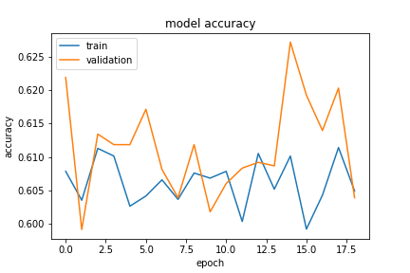
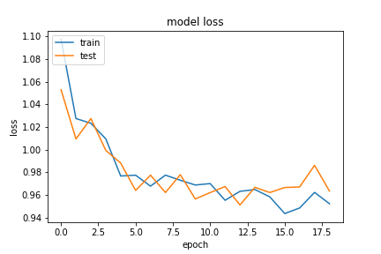
Findings – Run_15 (Maxpool)

Slide 13
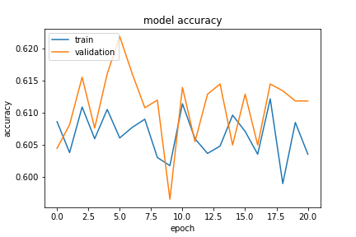
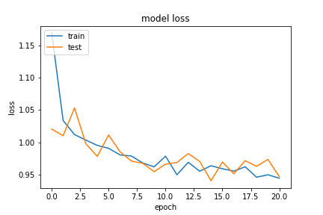
Findings – Run_16 (base model)

Slide 14
Results SUMMARY
- Switching Dropout layer to Maxpooling Layer after conv2D yielded good results when testing.
- Multiple architectures were trained and tested to investigate training and testing performances. E.g. minimize training time, improve accuracy.
- Throttle was set to constant due to unexpected error to prevent simulator model to steer offcourse.

Slide 15
Next steps
Further training of network with more data (>10k images)
Improve throttle output accuracy, and test data using joystick controller input.
Test different network architectures with different hyper parameters (activation, regularizes, image processing)
Test ResNet50, Recursive Network and other Reinforcement Learning models like DDQL.
Implement into real world track with a working donkey car.
Re-iterate training and testing models with real world data.

Slide 16
Special thanks
Adam Conway and William Roscoe, as well as the creator of the donkey car simulator donkey_gym by Tawn Kramer.

